Slide 1


Reflections on a Decade of Data Science 101: Key Insights and Lessons Learned
Slides and more
Todd Iverson
Winona State University
Winona, MN. USA

Slide 2
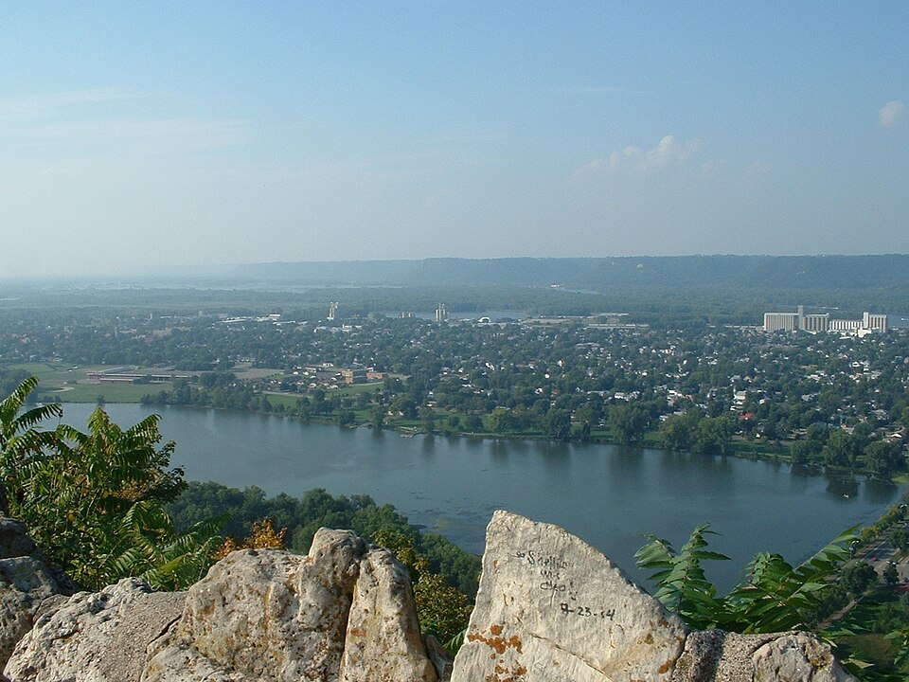
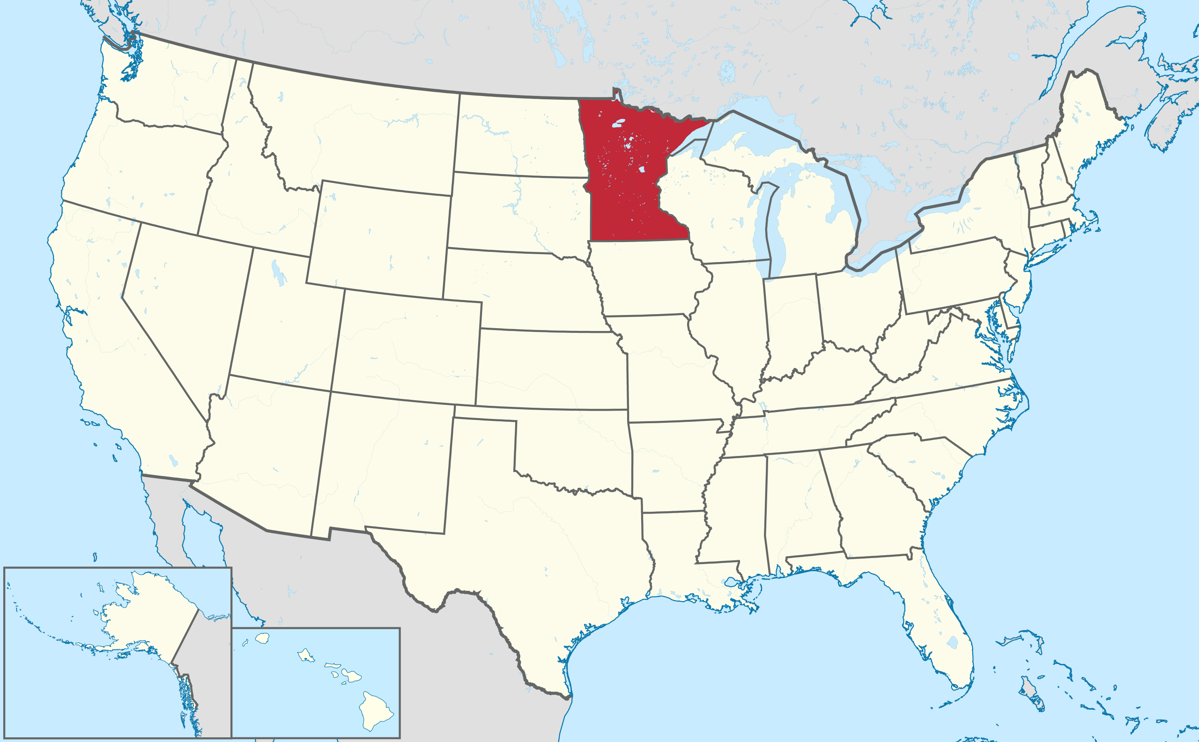
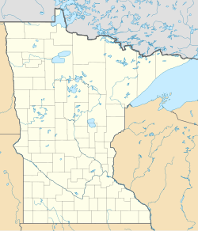
Winona State University
https://commons.wikimedia.org/wiki/File:Winona.jpg
Source: Wikipedia

Slide 3
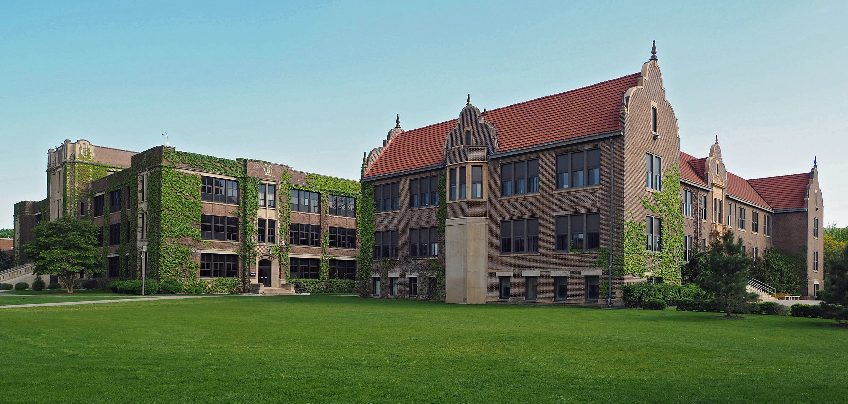
Winona State University
Part of the Minnesota State University System
~6000 undergraduate and graduate students
Two relevant undergraduate programs
BS in Statistics
BS in Data Science
10-20 majors per year
Source: Wikipedia

Slide 4

WSU Data Science Faculty
Todd
Iverson
Brant
Deppa
Silas
Bergen
Tisha
Hooks
April
Kerby
Chris
Malone
Visualization Materials
Interactive Apps

Slide 5
The Core Data Science Curriculum
Data Management
Visualization
Statistical Learning
DSCI 210
Survey
DSCI 210
Survey
DSCI 210
Survey
STAT 210/310
Intro Stats
DSCI 325
Structured
DSCI 326
DS @ Scale
DSCI 330
Unstructured
DSCI 310
Intro to Viz
STAT 360
Regression
DSCI 415
Unsupervised
Learning
DSCI 425
Supervised
Learning

Slide 6
The Introductory Course
Data Management
Visualization
Statistical Learning
DSCI 210
Survey
DSCI 210
Survey
DSCI 210
Survey
STAT 210/310
Intro Stats
DSCI 325
Structured
DSCI 326
DS @ Scale
DSCI 330
Unstructured
DSCI 310
Intro to Viz
STAT 360
Regression
DSCI 415
Unsupervised
Learning
DSCI 425
Supervised
Learning

Slide 7
Outline for DSCI 210
Intro to Tidy Data
Aggregation
Data Verbs
Intro to Visualization
Classification Trees
Managing Textual Data
Intro to R/tidyverse
Reshaping Tables
Combining Tables
Intro. to Association Rules

Slide 8
The Three Pillars of Data Science
Fundamental Question
How do we extract insights and value from data?
Data Management
Summaries
&
Visualization
Statistical Learning

Slide 9
DSCI 210 is a survey of data science
DATA MANAGEMENT
Intro to Tidy Data
Aggregation
Data Verbs
Intro to Visualization
Classification Trees
Managing Textual Data
Intro to R/tidyverse
Reshaping Tables
Combining Tables
Intro. to Association Rules
SUMMARY
TOOLS
STATISTICAL LEARNING

Slide 10
Key Insights and Lessons Learned
Group work works.
The 80% Rule.
The Payoff.
Technology Agnostic.
Low Code.
Translate to Code.

Slide 11
Group work works
Students work together on challenging tasks

Slide 12
Group work works How we structure a class session
Lecture/Demo
20 Minutes
Group Activity
80 Minutes
60 Minutes

Slide 13
Group work works
Advantages
Caveats
Include the whole data cycle
Messy data → Insight
Practice tackling harder tasks
Students need the practice
We have small classes
20-30 students
We have a perfect classroom
~5 students per round table
Shared screen

Slide 14
The 80% Rule
A data scientist spends 80% of their time managing data!

Slide 15
The 80% Rule Time spent on data management
Intro to Tidy Data
Aggregation
Data Verbs
Intro to Visualization
Classification and CART
Managing textual data
Managing data with R/tidyverse
Reshaping tables
Table joins
Intro to association rules

Slide 16
Basics of Managing Tabular Data
Basic
Advanced
Select columns
Filter rows
Transform columns
Aggregation
Simple
Grouped
Reshape tables
Stack similar columns
Unstack/Pivot columns
Set operations on similar tables
Union of rows
Joins
Inner join
Left/Right join
Outer join

Slide 17
The Payoff
Make sure you are working toward some insight

Slide 18
Outline for DSCI 210 Don’t forget the payoff!
Exercises work toward some insight
Summary/Viz/Model
Intro to Tidy Data
Aggregation
Data Verbs
Intro to Visualization
Classification and CART
Managing textual data
Managing data with R/tidyverse
Reshaping tables
Table joins
Intro to association rules
Analytic tools ASAP!

Slide 19
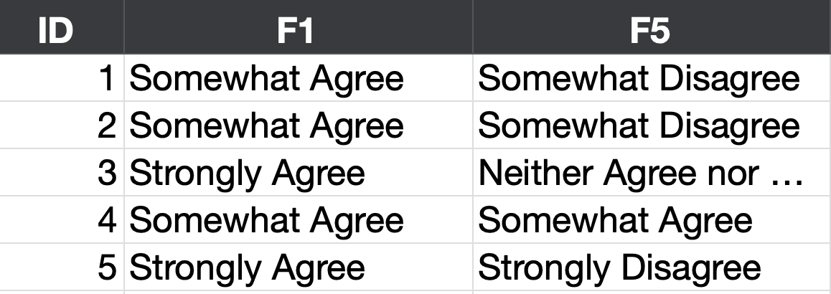
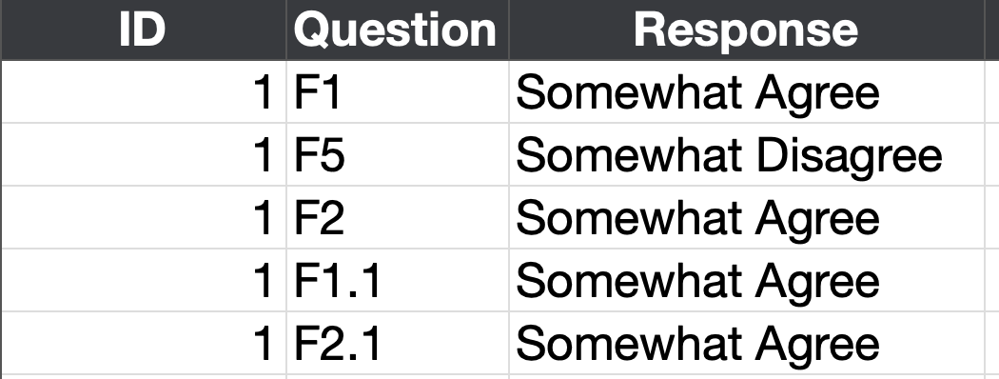
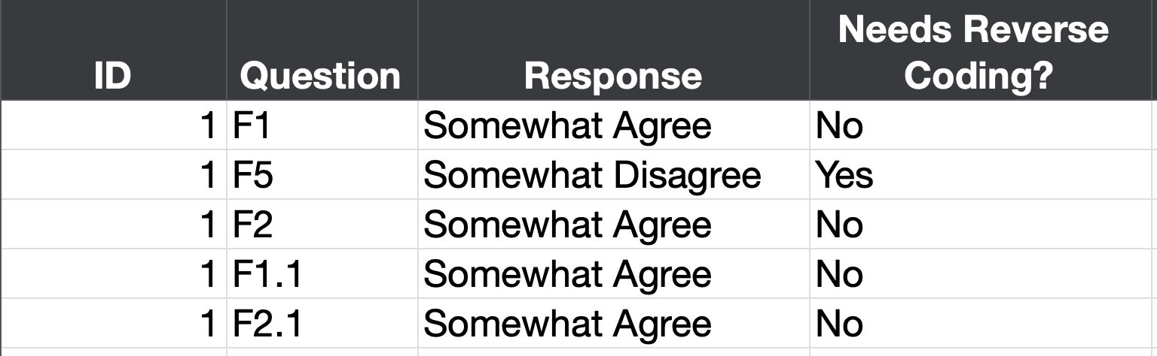
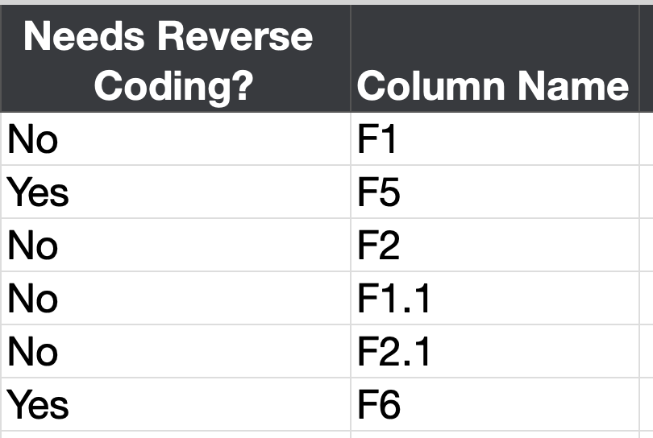
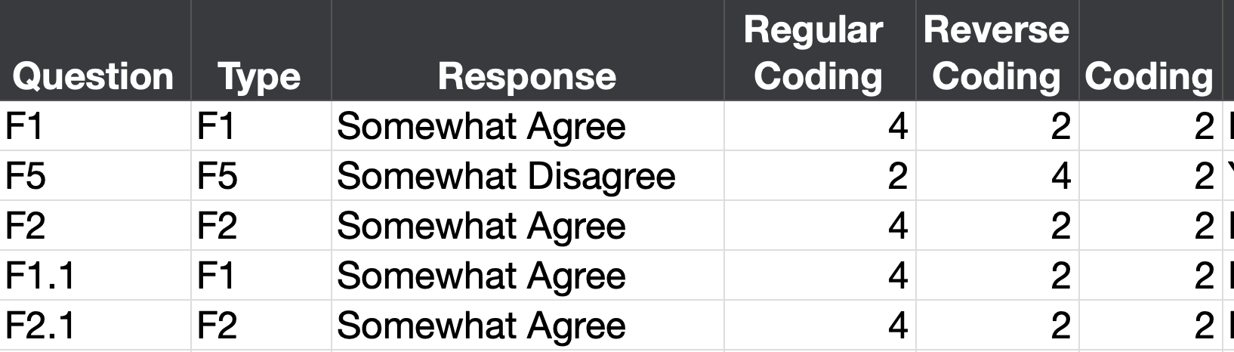
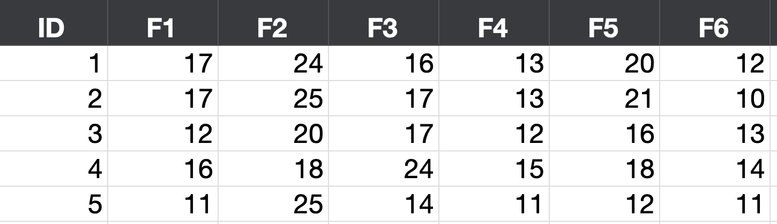
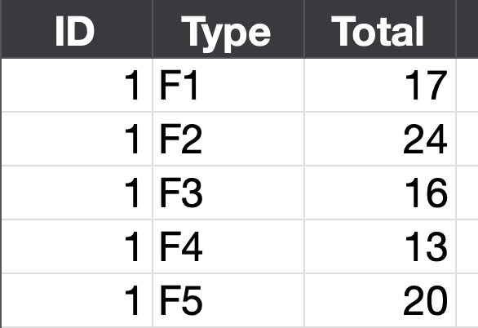
Response Table
Stacked Response Table
Joined Table
Reshape
Join
Agree?
Disagree?
Transform
Question Table
Unstack
Aggregate

Slide 20
Response Table
Stacked Response Table
Joined Table
Reshape
Join
Agree?
Disagree?
Transform
Question Table
What did we learn?
The Payoff
Unstack
Aggregate

Slide 21
Technology Agnostic
Teach concepts before specific technology

Slide 22
Technology Agnostic Data Verbs
Data Management
Summaries
&
Visualization
Statistical Learning
D | G
5 | a
3 | a
4 | b
2 | b
3 | c
5 | c
4 | c
D
5
3
4
2
3
5
4
D | G
5 | a
3 | a
4 | b
2 | b
3 | c
5 | c
4 | c
Filter (G is not a)
Select (D)
D | G
4 | b
2 | b
3 | c
5 | c
4 | c
D | G
5 | a
3 | a
4 | b
2 | b
3 | c
5 | c
4 | c
D | G | N
5 | a | 10
3 | a | 6
4 | b | 8
2 | b | 4
3 | c | 6
5 | c | 10
4 | c | 8
D | G
5 | a
3 | a
4 | b
2 | b
3 | c
5 | c
4 | c
D | G
2 | b
3 | a
3 | c
4 | b
4 | c
5 | a
5 | c
Mutate (N = 2*D)
Sort (D, G)

Slide 23
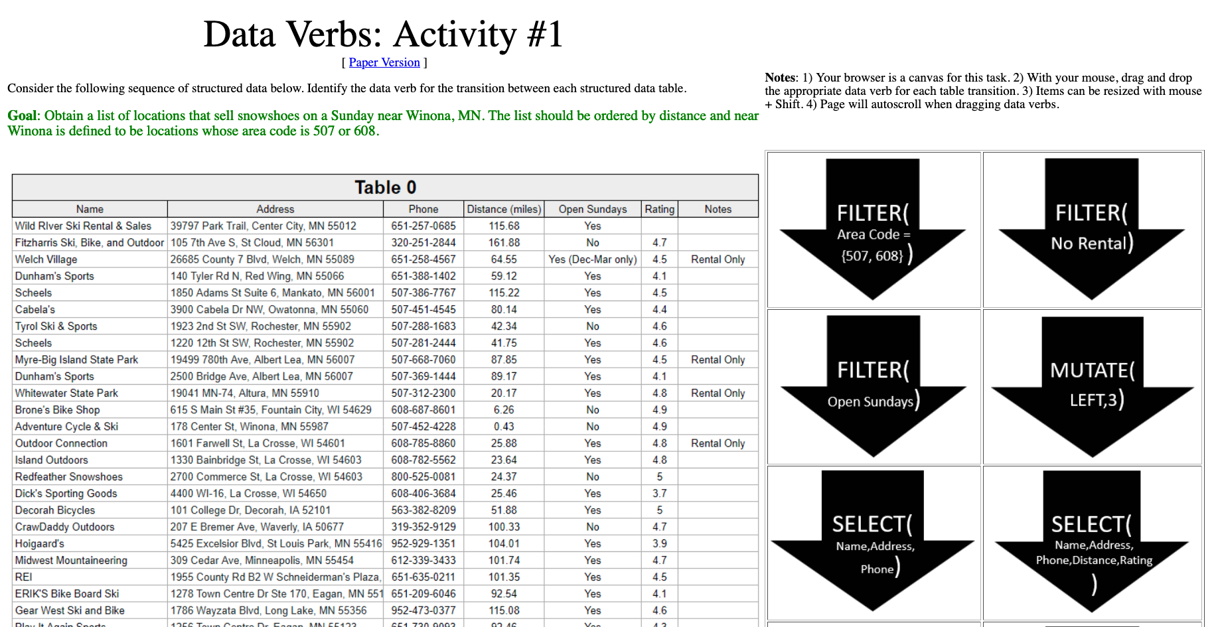

Exercise 1 Purchasing Snowshoes
http://statsclass.org/dsci210/Dataverbs/

Slide 24
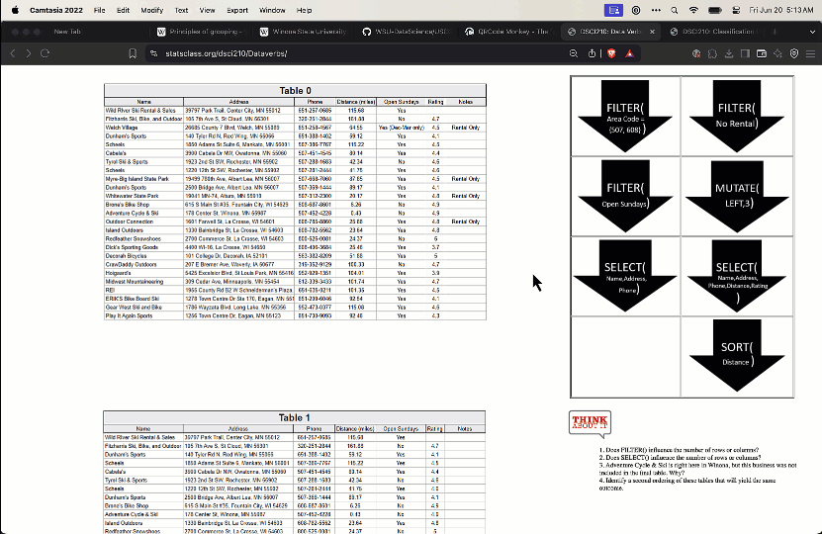
Interactive Activity on Data Verbs

Slide 25
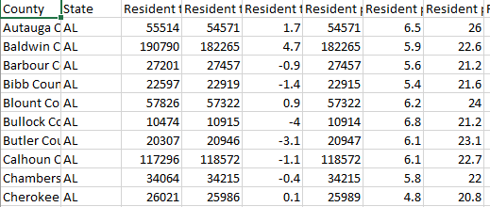
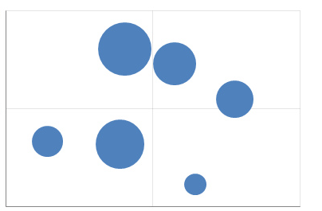
Technology Agnostic The grammar of graphics
Data Management
Summaries
&
Visualization
Statistical Learning
What is a data visualization?
Aesthetic
Map
Examples
Tableau
Graph Builder (JMP)
ggplot (R)
Altair (Python)
Data
Geom/Mark
Vega & Vega-lite (JavaScript)
A map from data to the visual aesthetics of geometries/marks

Slide 26
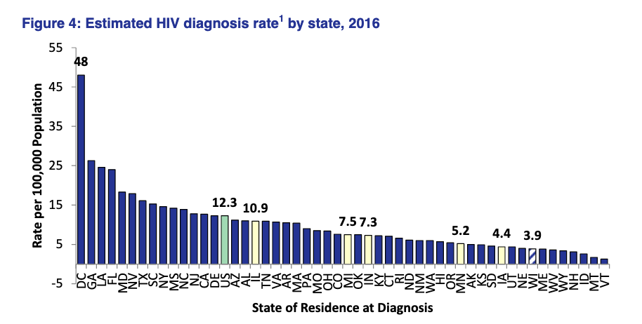
Technology Agnostic Graphical Specifications
Data Management
Summaries
&
Visualization
Statistical Learning
Data row:
WI HIV data
Geometry:
Bar
Variables/mapping:
Y is HIV diagnosis per 100,000
X is state
Color is region
Modifiers
Annotation (some bar heights)
Sort X by rate
Graphical Specification
https://www.dhs.wisconsin.gov/publications/p00484.pdf
Notes:
Quickly; add “key” slides

Slide 27
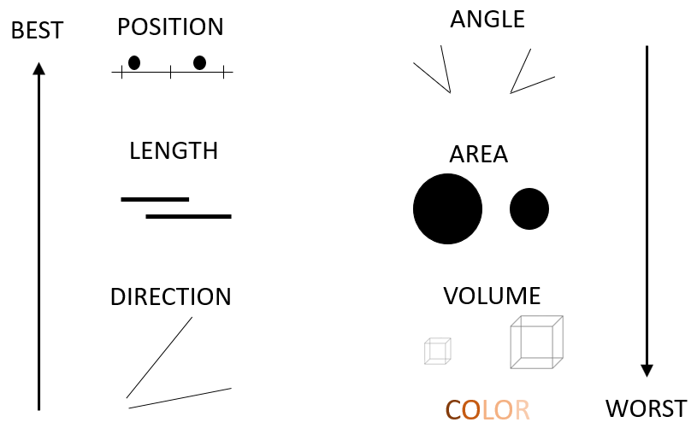
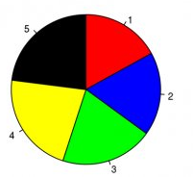
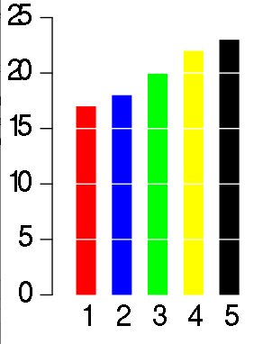
Technology Agnostic Visual perception
Data Management
Summaries
&
Visualization
Statistical Learning
Cleveland’s and McGill’s
hierarchy of elementary perceptual tasks
Task 1: Complete the two polls.
Largest?
3rd place?
Task 2: Complete the two polls.
Largest?
3rd place?

Slide 28
Technology Agnostic Gestalt principles of grouping
Data Management
Summaries
&
Visualization
Statistical Learning
Proximity
Similarity
Connection
Closure
Foreground/Background
Continuity

Slide 29
Exercise 2 Sketch a redesign

Slide 30
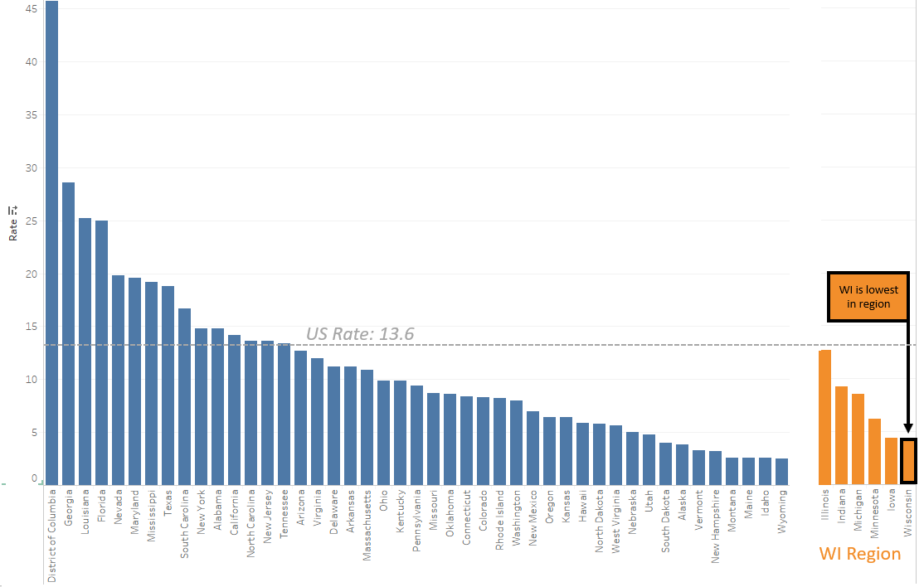
Solution
Annotations
Another crucial technique
(see Alberto Cairo)

Slide 31
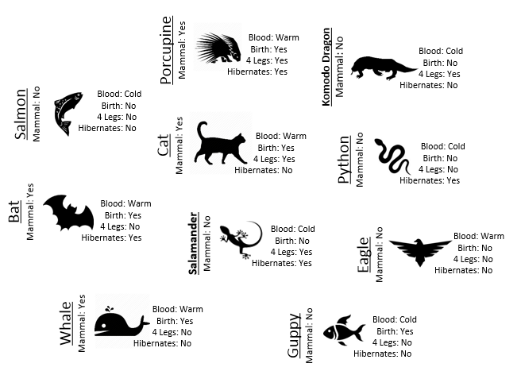
Technology Agnostic Classification using CART
Data Management
Summaries
&
Visualization
Statistical Learning

Slide 32
Goal: Build a tree-based classifier for Mammal

Slide 33
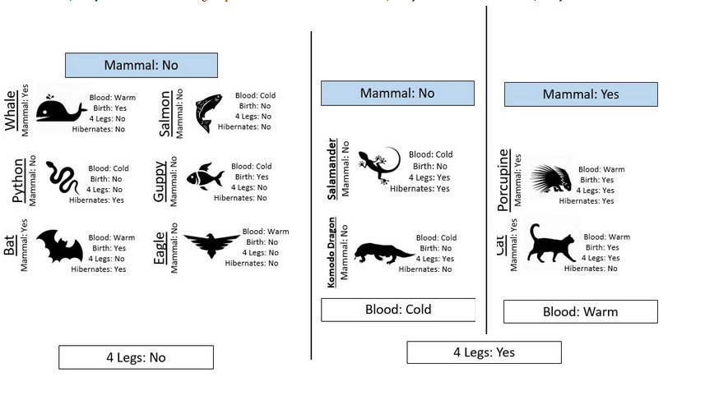
Step 1 Building a classifier using the TRAINING DATA
All Cases
4 Legs: No
4 Legs: Yes
Not Mammal
Blood:
Cold
Blood:
Warm
Not Mammal
Mammal
http://www.statsclass.org/dsci210/CART/train.html

Slide 34
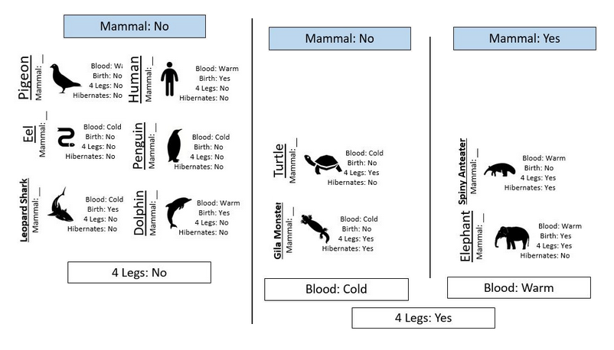
Step 2 Evaluate the classifier using the TEST DATA
✅
✅
✅
✅
✅
✅
✅
✅
http://www.statsclass.org/dsci210/CART/test.html

Slide 35
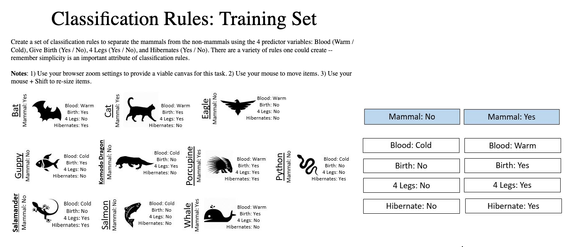
Exercise 3 Make your own rule (different than mine)
http://www.statsclass.org/dsci210/CART/train.html
http://www.statsclass.org/dsci210/CART/test.html

Slide 36
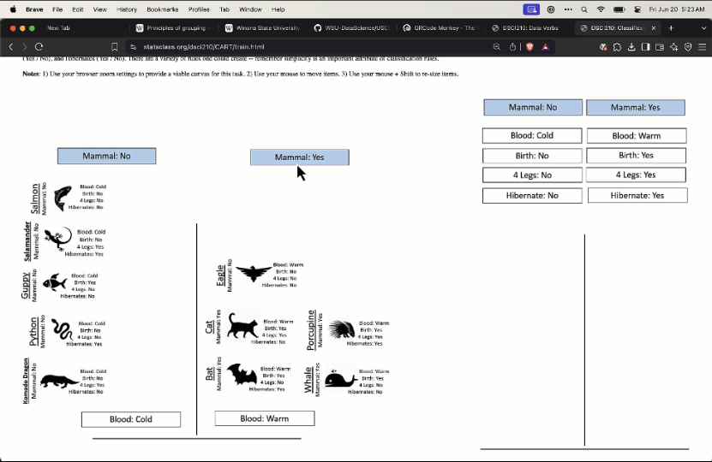
Interactive CART activity

Slide 37
Low Code
Start with technology that minimizes the need for code

Slide 38
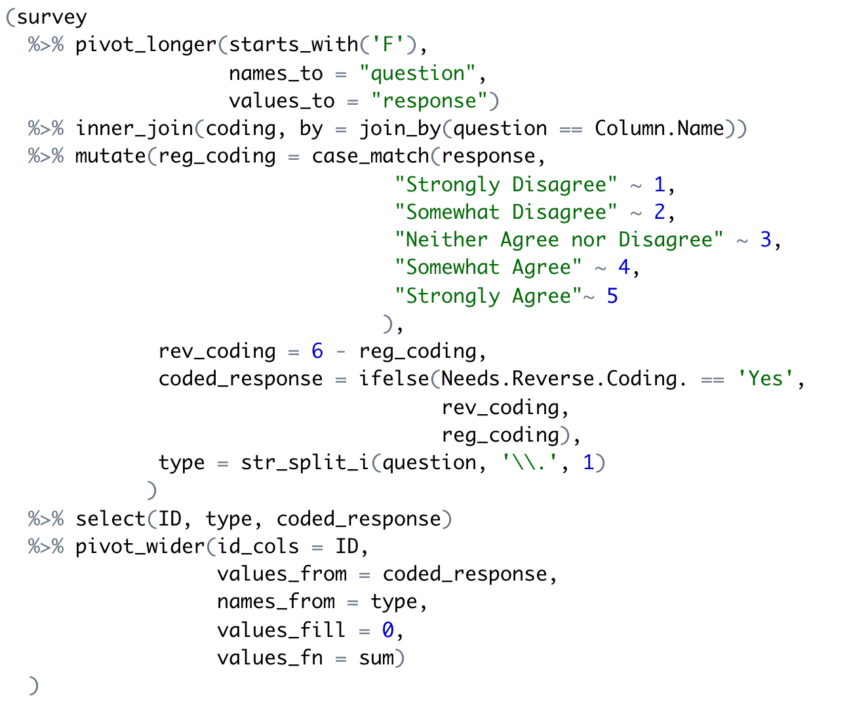
Learning to program is hard!
What should I do first? Second?
What functions should I use?
How do I make my code run/correct?

Slide 39
Doug is struggling!
Algorithm
Step-by-step process
What should I do first? Second?
What functions should I use?
How do I make my code run/correct?

Slide 40
Doug is struggling!
Algorithm
Step-by-step process
What should I do first? Second?
Implementation
Which libraries/functions
What functions should I use?
How do I make my code run/correct?

Slide 41
Doug is struggling!
Algorithm
Step-by-step process
What should I do first? Second?
Implementation
Which libraries/functions
What functions should I use?
Correct Code
Avoid bugs and verify correct results
How do I make my code run/correct?

Slide 42
We decouple the algorithm and the code!
Notes:
Then just in the nick of time …

Slide 43
The algorithm is most important Let’s make sure Doug is proficient here first!
Algorithm
Step-by-step process
Start here!
What should I do first? Second?
Implementation
Which libraries/functions
What functions should I use?
Correct Code
Avoid bugs and verify correct results
How do I make my code run/correct?

Slide 44
Coding should come later in the first course
Outline for DSCI 210
Low Code
Scripting + Low Code
Intro to Tidy Data
Aggregation
Data Verbs
Intro to Visualization
Classification and CART
String Verbs and Window Functions
Managing data with R/tidyverse
Reshaping tables
Table joins
Intro to Arules

Slide 45
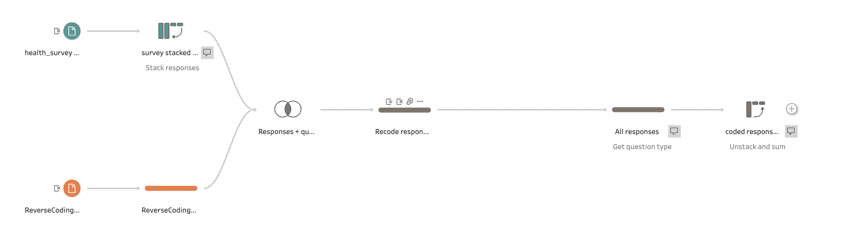
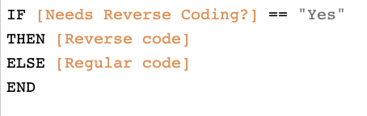
Low Code Data management with Tableau Prep
Data Management
Summaries
&
Visualization
Statistical Learning
Only Code

Slide 46
The Tableau Prep visual interface
Load Data
Stack columns
Pivot
Unstack & Aggregate
Join
Transform
Transform
Load Data

Slide 47
Low Code Data management with Tableau Prep
Data Management
Summaries
&
Visualization
Statistical Learning
Only Code

Slide 48
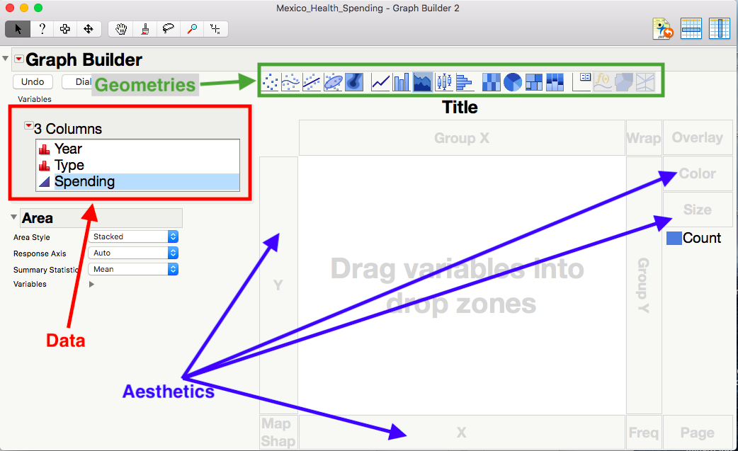
Low Code Visualizations using JMP Graph Builder
Data Management
Summaries
&
Visualization
Statistical Learning

Slide 49
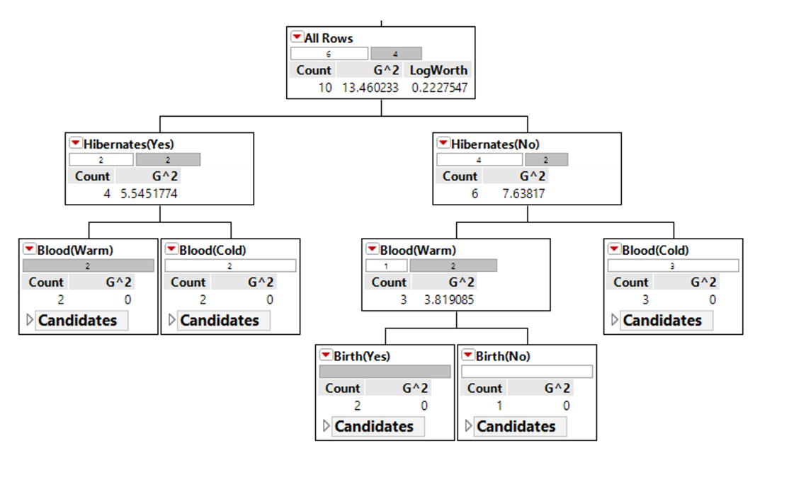
Low Code CART using JMP Partition
Data Management
Summaries
&
Visualization
Statistical Learning

Slide 50
Translate to Code
Implementing code from low code solutions

Slide 51
Translate to Code From Tableau Prep to dplyr
Data Management
Summaries
&
Visualization
Statistical Learning

Slide 52
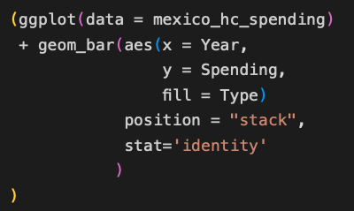
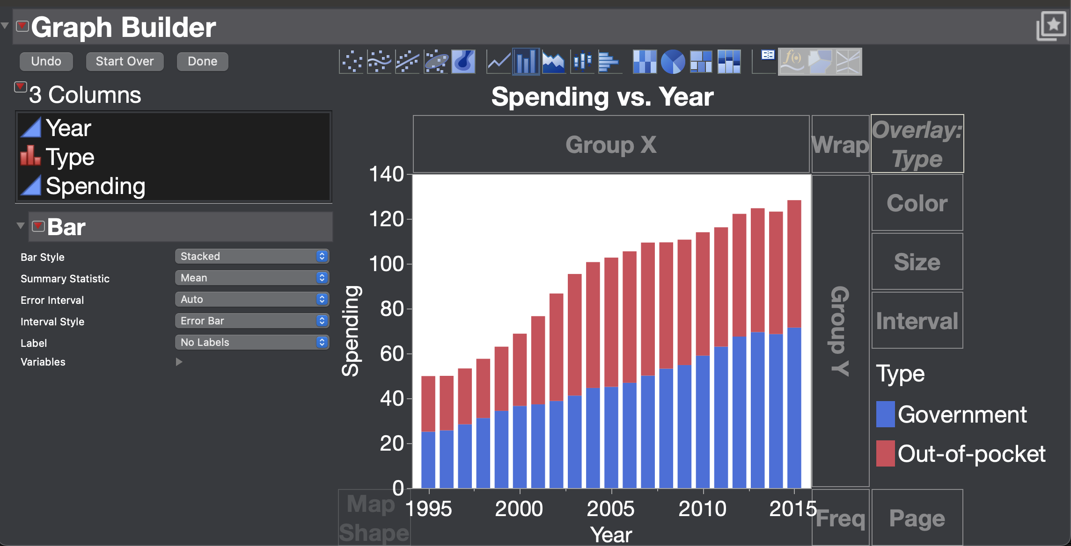
Translate to Code From Graph Builder to ggplot
Data Management
Summaries
&
Visualization
Statistical Learning
Graphical Specification
Data: Mexico HC data
Geometry: Bar
Mappings
Year → X
Spending → Y
Source → Hue
Modifier: Stack

Slide 53
Key Insights and Lessons Learned
Group work works. Students work together on challenging tasks
Technology Agnostic. Decouple the core concepts and technology.
The 80% Rule. Don’t ignore where a data scientist spends all her time …
The Payoff. ... but always work toward some insight.
Low Code. Teach them data science with minimal code first.
Translate to Code. Implement code for low code solutions

Slide 54
Thanks for attending! Feel free to reach out
Slides and more
Todd Iverson
tiverson@winona.edu

Slide 55
Demos
As time permits

Slide 56
Exercise 1 Purchasing Snowshoes
http://statsclass.org/dsci210/Dataverbs/

Slide 57


Exercise 3 Make your own rule (different than mine)
Train
Test
http://www.statsclass.org/dsci210/CART/train.html
http://www.statsclass.org/dsci210/CART/test.html

